Slide 1
PowerShell Shenanigans Lateral Movement with PowerShell
Kieran Jacobsen
Notes:
Welcome to Powershell Shenanigans, or more appropriately named, lateral movement with PowerShell.

Slide 2
About:Me
Kieran Jacobsen
Microsoft/Automation/Security focus
Twitter: @Kjacobsen
Blog: Aperturescience.su
Notes:
For those of you who don’t know me, I am Kieran Jacobsen, for the last 2 and a bit years I have worked for HP Enterprise services as an something engineer turn architect. I have an interesting set of intersecting skills, initially I had a Microsoft technology focus, which has crossed into automation with a big side in computer security.

Slide 3
Outline
PowerShell as an attack platform
PowerShell malware
PowerShell Remoting & WinRM
PowerShell security, and bypassing that security
Defence
Notes:
So just quickly an overview of what I will be covering tonight. Firstly we will look at why PowerShell is a good attack platform, then look at some malware in the wild written in PowerShell, then look at Remoting and WinRM, then onto PowerShell security and how we can bypass it, and finally how we can defend ourselves. I will have some demos missed through just to keep it interesting.
Just as some disclosure, I recently did a more security focused and much shorter version of this presentation to a new Brisbane security conference, CrikeyCon. For those of you unaware of it, CrikeyCon is essentially the security version of Infrastructure Saturday. It has a great turn out, and I am told will be returning next year! I did my presentation in March at that conference and didn’t expect much of a response, needless to say I was surprised. I was asked a few days later to be on the Risky Business Podcast and there has been much chatter about what I covered.

Slide 4
Challenge
Move from social engineered workstation to domain controller
Where possible use only PowerShell code
Demo environment will be a “corporate like” environment
Notes:
To show you how PowerShell can be put to mischieve use. I am going to guide you through a simple hacker challenge, something that most in the security industry would be aware of. This one was given to me by a friend a few years back. The challenge is simple, with a social engineered attack infecting a workstation in a corporate like environment, steal the active directory hashes. Seems simple, get in, pwn the domain controller and then pop the hashes out. He added a challenge though, I could only use PowerShell and built in functions, now he releated and let me use one 3rd party executable.
So what makes the demo environment a “Corporate like” environment? Well there are similar design decisions. Firstly, there is a client running Windows 8.1, a domain controller running windows server 2012 r2, and a UTM firewall from a reputable vendor. Like a lot of corporate environments, both big and small, the users are still local admins. We all know this is bad, but alas, it still happens. There was also a configuration fall during the deployment of a management service within this network. During a late night, one of the sys admins made a service account domain admin. It fixed whatever he was working on, but due to poor controls, no one has addressed this sloppy configuration issue. This is a configuration issue I have seen time and time again.
Next, the firewall. This is actually pretty secure. It is only allowing HTTP and HTTPS out, DNS from the domain controller. Not bad at all. It isn’t doing any fancy AV scanning, but it does filter URLS looking for malicious addresses. It was pretty much the stock configuration from the vendor.
Overall, everything else is pretty much the same. There isn’t any group policy changes, everything was installed in a standard manner.

Slide 5
Advantages as an attack platform
Code is very easy to develop
Windows integration
Plenty of remote execution options
Designed for automation against 1 – 10000000 devices
Limited security model
Antivirus products are no real concern/limitation
Scripts can be easily hidden from administrators
Installed by DEFAULT
Notes:
So why should we consider PowerShell as an effective attack platform? Well, for the same reasons that PowerShell is a good automation platform, it’s a good attack platform.
PowerShell code is incredibly easy to develop and understand. You can very quickly and easily write complex pieces of code, it allows you to rapidly develop attack code, update code based upon changing situations.
Next, Microsoft’s aim with PowerShell was for it to be heavily integrated with Windows, the .Net framework and finally all of their product families. This means our attack platform will be heavily integrated with these. Combine that with Microsoft providing a number of different ways to execute code against remote machines, and thus you end up with a very suitable lateral movement platform. Microsoft designed PowerShell for large scale task automation, servicing dozens even hundreds of devices at a time, and this allows us to attack dozens and even hundreds of devices in a network at a time.
We will talk about it later, but PowerShell’s incredibly friendly and simple security model limits how we can protect our selves from PowerShell being used maliciously. It’s a good, but not great security model.
What about our AV? Maybe they can protect us, well, the answer is they really don’t check for malicious PowerShell code. They are aware of a couple of malicious scripts, but they really haven’t started looking at the code like they have previously with VBScript. One other thing to point out is that a lot of application white list deployments will whitelist powershell.exe by default. Nice one guys!
The human element is something else to consider. Administrators expect to see scripts, and they are probably writing scripts and putting them in various places on the system. It would be very easy to hide just a bit more code on the hard disk. Administrators often expect to see PowerShell.exe in the running task list, so once again, another instance running isn’t going to ring any alarm bells.
Finally, its there by default, its installed by default. What is better than something already there?

Slide 6
Real world PowerShell Malware
Prior to March 2014, only a few minor instances
PowerWorm:
Infect’s Word and Excel documents, initial infection via macro in .doc/.xls
First spotted by TrendMicro, analysis and rewrite by Matt Graeber (@Mattifestation)
PoshKoder/PoshCoder:
PowerWorm crossed with CryptoLocker
Bitcoin ransom
Notes:
So prior to March, there really hadn’t been much in the malware written in PowerShell sector. There had been a few attempts at randomware and worms, but nothing serious and nothing that was hard to clean up.
This has changed since my CrikeyCon presentation. At the end of March, TendMicro did a small blog post on some malicious code they had dubed, PowerWorm. When they first posted, numerous PowerShell security interested folk were quick to ask for more information. Trend didn’t say much apart from the use of PowerShell. Matt Graeber managed to get a sample of the code, and has performed an amazing analysis of the code, links at the end. Matt has also done a rewrite of the majority of the code, so you too can look and learn from the sample.
A few weeks later however, Matt and others saw a post on BleepingComputer.Com. The malware is called PoshKoder, with either a c or k spelling, and is similar to PowerWorm with an infection method based upon word and excel documents, but this time its picked up the functionality of CryptoLocker. PoshKoder encrypts users files, with a key that is sent securely to a server. Users need to pay a bitcoin fee to get their files back. Now this was working, but now there are reports of the server not sending back the right keys.
PowerShell malware is a very real threat. Whilst right now, the recorded instances are pretty harmless, they are becoming more dangerous.

Slide 7
My PowerShell Malware
Single Script – SystemInformation.ps1
Runs as a schedule task, every 5 minutes
Script:
Collects system information and more
Connects to C2 infrastructure, downloads a task list and executes tasks
Executes each task, if successful, task will not be rerun
Tasks can be restricted to individual computers
Notes:
So I made a little script, I suppose it could be called malware, which will run on a system and allow you to have remote control over the system. If I have time, I will show you, but I am not going to go into specifics today as the code will be put up onto GitHub for you to take a look. The script is cleverly called SystemInformation.ps1, in the hope users and administrators don’t work out what it is. The script will be setup to run as a scheduled task, running as local system, every 5 minutes. There is a number of different ways we could manage to set this up, in the demo it will be occurring through an Excel macro, however you could use almost anything, as long as the script is downloaded, and the task is created.
When the script executes, it will do a few things. Firstly, it will collect system information and some poorly secured credentials, it also connects to the command and control infrastructure and downloads a list of tasks to execute. Tasks can be any valid PowerShell expression, a PowerShell expression, an executable, as long as it is a valid expression. Tasks, if successfully executed will only be run once, they can also be limited to executing on a single PC.

Slide 8
Demo: The entry

Slide 9
Windows PowerShell Remoting and WinRM
PowerShell Remoting is based upon WinRM, Microsoft’s WS-Management implementation
Supports execution in 3 ways:
Remote enabled commands
Remotely executed script blocks
Remote sessions
Security Model = Trusted Devices + User Credentials
WinRM is required for the Windows Server Manager
WinRM is enabled by DEFAULT on Windows 2012(R2) Server
WinRM is allowed through Windows Firewall on all network profiles!
Notes:
So there have been some interesting changes in terms of security with the introduction of Windows PowerShell Remoting, and WinRM. PowerShell remoting allows us to remotely execute PowerShell code on one or more remote systems, based upon the WinRM or Windows Remote Management Interface. WinRM is based upon the WS-Management protocol. Remoting gives administrators a number of execution options, firstly, a large number of powershell commands have been extended to allow for their execution against remote devices directly. Next administrators can also run a powershell script block remotely, in an experience much like rexec or using ssh to run a remote command. Finally, administrators could start a remote session, much like connecting into a full blown ssh session.
Security for WinRM is governed by two things, firstly, clients can only connect to devices they trust, which can be manually configured in workgroups, or in domain joined environments, clients trust everything. User’s need the appropriate credentials, typically local admin. Finally there are some authentication protocol specifications, but they typically aren’t a huge issue.
Now for the kicker of it all. Windows Server 2012, and 2012R2 introduces a new unified Windows Server Manager, trumpeted by Microsoft as an advancement of server administration, it introduces a critical flaw. The entire thing runs on WinRM, and to make things easier, Microsoft made the wonderfully helpful decision to setup, configure WinRM for you, by default when you install Windows Server 2012 R1 and R2. That’s right, on by default. After years of them telling us, pretty much yelling off by default, something is now on by default. It gets worse folks, the windows firewall permits the incoming connections on all network profiles, even public!
Now at CrikeyCon I made two minor mistakes. I miss read two Microsoft documents. I said at CrikeyCon that it was only domain joined Windows Server 2012 systems which had it on, I was wrong, its all. Secondly I said that installing the PowerShell 4 bundles would do the same thing on 2008R2, and it appears that was incorrect. Anyway, some is worse, some is better.

Slide 10
Demo: The DC

Slide 11
PowerShell Security Features
Administrative rights
UAC
Code Signing
Local or Remote source using zone.identifier alternate data stream
PowerShell Execution Policy
Notes:
In terms of security features, it follows the usual windows security pattern. As expected, Administrative rights and UAC govern what we can and cannot do. As expected if you needed admin rights before, you will still need them, and the same goes with UAC elevation.
You can protect your scripts and modules with Code Signing. Signing scripts has been made easier over the last few years, however the usual vulnerabilities still apply.
An interesting aspect is that PowerShell is that it will look at the NTFS zone.identifier alternate data stream to determine the source for a script or module. This is the same functionality that causes that prompt for confirmation when you run that setup executable you downloaded off the internet.
If you combine the source identification and code signing, then you have PowerShell’s Execution Policy feature. The execution policy is a feature within PowerShell that allows an administrator to control what scripts execute and what modules can be loaded into a session. It is Microsoft’s attempt at preventing malicious code. Different policy states allow and disallow scripts to run and modules to be loaded. Policy can be specified at a session, user and computer level, via the registry or group policy. Let’s take at the different policy states.

Slide 12
Execution Policy
There are 6 states for the execution policy
Unrestricted All scripts can run
Remote Signed No unsigned scripts from the Internet can run
All Signed No unsigned scripts can run
Restricted No scripts are allowed to run
Undefined (Default) If no policy defined, then default to restricted
Bypass Policy processor is bypassed
Notes:
There are 6 different states.
First we have unrestricted, this is the least secure state and allows us to run any script, no matter where it came from. Then we have remote signed, with remote signed, if a script came from a source other than the local pc, it must be signed; any script from say the internet, which is signed, will be executed. Then we have all signed, here we will not run any script, no matter the source, unless it has been signed. Then there is restricted, in this state, no scripts can run.
There are two special states, undefined, which is the policy if none has been set, this actually defaults to the restricted policy, and finally bypass, which is primarily used when calling PowerShell scripts from applications, in bypass the policy processer is, well, bypassed.
So, you are probably thinking, well this looks like decent security…what if I told you, I can get a script to run, no matter the execution policy specified?

Slide 13
Bypassing Execution Policy
Simply ask PowerShell: powershell.exe –executionpolicy unrestricted
Switch the files zone.idenfier back to local: unblock-file yourscript.ps1
Read the script in and then execute it (may fail depending on script)
Encode the script and use –encodedcommand → always works!!!!!
Get/Steal a certificate, sign script, run script
Notes:
So how can I run a PowerShell script without changing the computer or user defined policy?
Well firstly, if the administrators haven’t used group policy to specify a particular policy, we can simply ask powershell to use a different one when we run it.
If an administrator has specified remote signed, then we can set the zone identifier to say it hasn’t come from the internet, in effect bypassing his control.
If that doesn’t work, say they set all signed or restricted. Then simply read the file in, turn it into a single executable expression, that is, not multiple lines, and then run that.
Next, encode your script. You can encode your script to a base64 string, and then use the –encodedcommand parameter when calling PowerShell. Best thing with this is that, you bypass all execution policy settings -> brutal isn’t it. Why is this there, its pretty much to do with sending complex parameters to scripts according to Microsoft, which to mean doesn’t explain the bypass of the execution policy.
Finally, and probably easier for some, simply obtain or steal a certificate.
I am going to say this. Whilst administrators are probably setting one of these levels for their workstations, they probably are not doing this on their servers. Pretty much ever server I come across, will have the policy of unrestricted. I would almost bet that there is one in everyone's windows server environment.

Slide 14
Demo: The HASHES

Slide 15
Defence of the dark arts
Restricted/Constrained Endpoints
Change WinRM Listener
Change Windows Firewall settings
Turn it off WinRM
Application whitelisting
Notes:
So when I presented at CrikeyCon, I didn’t provide much advise on what todo in terms of defence. To be honest, I just hadn’t considered it that much. Then a few days later I was interviewed on the Risky Business podcast, and whilst I explained my thoughts on preventing rogue PowerShell scripts, and also restricting WinRM; there was quite a few people who disagreed with me. Anyway, whilst I feel people still don’t quite understand, let’s look at some defence of the dark arts.
Firstly, you can look at PowerShell restricted or constrained endpoints. These are basically PowerShell instances which are restricted in some manner, typically with a start up script or using a configuration file. In these we can limit not only what PowerShell cmdlets we can access but also what applications we can run. It is a good way of limiting what an attacker might do in a PowerShell session, but do remember it can limit you, your fell admins or even your developers. It can be quite effective if you take the time and implement it right. Perhaps I might do a presentation at Infrastructure Saturday on constrained endpoints.
Next, some people change what interfaces and stuff their WinRM listen on. Say for example you have a management network, then you could listen only for connections on that subnet or something. Good, but not a great defence.
Next, you can limit who can access the WinRM interface by changing the Windows Firewall, this one is also another good idea, but isn’t great.
Of course, if you don’t remotely manage your servers, you are odd and just use the server manager on each server separately or something. Then why not turn it off? If you are not using WinRM or any of the other remote management components, turn it off. You can’t be exploited if its turned off.
Another recommendation is to use Application White listing. This one I do recommend. Apparent from the obvious security advantages at stopping malicious executables, this can help control scripts as well. If you are not using application white listing on your workstations, why aren’t you? This will save you!

Slide 16
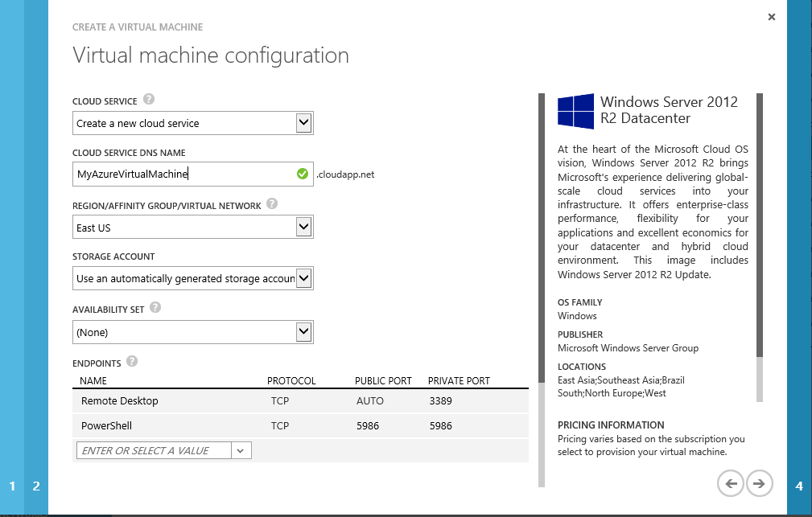
WinRM, not just an Internal Issue
By default, Microsoft Azure virtual machines expose HTTPS listener to the Internet.
Notes:
I just want to point out, that this isn’t simply an issue in your internal networks, don’t forget Microsoft Azure.
By Default when creating a virtual machine, WinRM is exposed to the internet, that PowerShell endpoint in the wizard is exposing your WinRM endpoints to the public internet.

Slide 17
Links
Twitter: @kjacobsen
Blog: http://aperturescience.su
Code on GitHub: http://j.mp/1i33Zrk
QuarksPWDump: http://j.mp/1kF30e9
PowerSploit: http://j.mp/1gJORtF
PowerWorm Analysis: http://j.mp/RzgsHb
PowerBleed: http://j.mp/1jfyILK

Slide 18
More Links
Microsoft PowerShell/Security Series:
http://j.mp/OOyftt
http://j.mp/1eDYvA4
http://j.mp/1kF3z7T
http://j.mp/NhSC0X
http://j.mp/NhSEpy
Practical Persistence in PowerShell: http://j.mp/1mU6fQq
Bruteforcing WinRM with PowerShell: http://j.mp/1nBlwX2

